Slide 1

Chassis

Slide 2
Rules and Limitations

Slide 3

Rules and Limitations
Driver’s helmet must have a clearance of 6 in to the side surfaces
Driver’s torso, arms, legs, shoulders, hands, hips, thigh, knees and elbows must have a clearance of 3 in to the side surfaces.
Vehicle
Vehicle/Dimensions | Long | Tall (frame) | Width
Rules | 108 in | N/A | 64 in
Z6 | 95 in | 48 in | 64 in
Z7 | 82.5 in | 50 in | 64 in
Z8 | 88 in | 48.5 in | 63.5 in
ZR 2016 | 75.68 in | 45.625 in | 62 in
ZR 2017 | 86.82 in | 46.125 in | 62 in

Slide 4
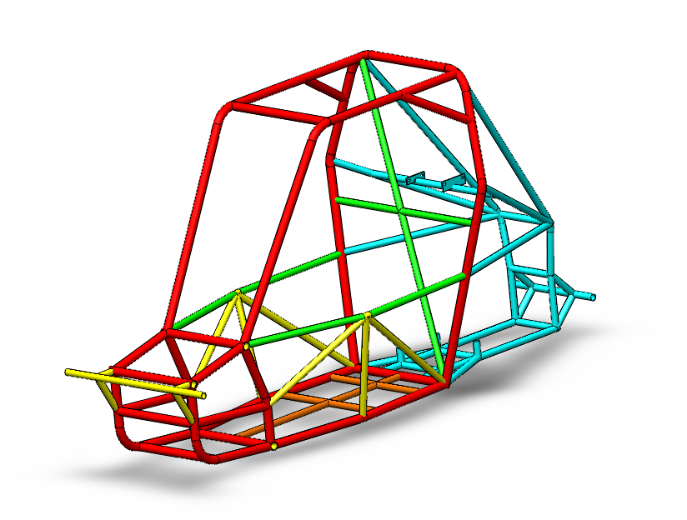
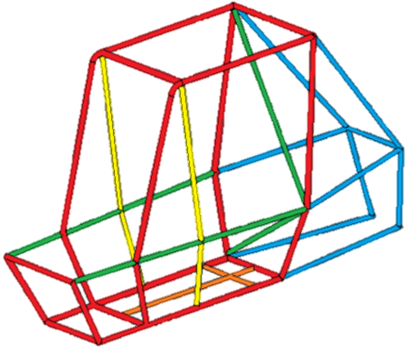
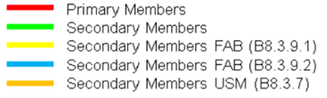
*Secondary members must be steel tubes having a minimum wall thickness of 0.89 mm (.035 in) and a minimum outside diameter of 25.4 mm (1.0 in
 | Outside diameter | Wall thickness
P. Member | 1.25 | .065
S. Member | 1 | .065
S. Member | 1 | .065
S. member | 1 | .065
S. member | 1 | .065

Slide 5
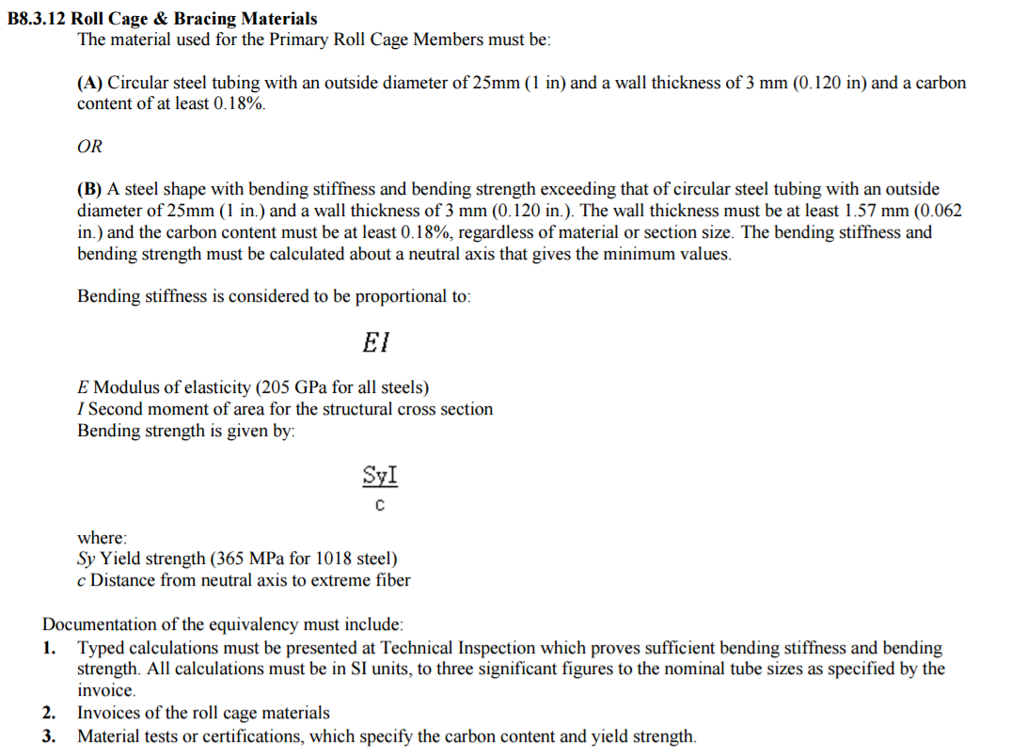
Rules and Limitations

Slide 6
Rules and Limitations
 | Recommended tubing specification | Designed tubing specification
Modulus of elasticity | E=205 Gpa (29700 ksi) | E=205 Gpa (29700 ksi)
Outer Diameter | Do=25.4 mm | Do=31.75 mm
Thickness | t= 3.05 mm | t= 1.651 mm
Inner Diameter | Di= 19.3mm | Di= 28.448 mm
Are moment of inertia | I= 13620.9 mm^4 | I= 17732.4 mm^4
Yield Strength | Sy= 365MPa (53 000 psi) | Sy= 690MPa (100 264 psi)
Distance to extreme fiber | c=12.7 mm | c=15.875 mm
Bending strength | 3.915e5 N-mm | 7.707e5 N-mm

Slide 7
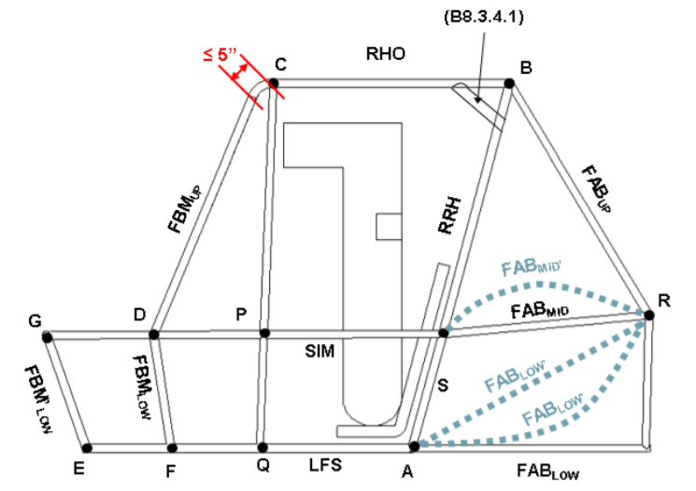
Structural Members
RRH: Rear Roll Hoop
RHO: Roll Hoop Overhead Members
FBM: Front Bracing Members
ALC: Aft Lateral Cross Member in Rule B8.3.3
BLC: Overhead Lateral Cross Member
FLC: Front Lateral Cross Member in Rule B8.3.4
CLC: Upper Lateral Cross Member
DLC: SIM Lateral Cross Member
LFS: Lower Frame Side Members
LDB: Lateral Diagonal Bracing
SIM: Side Impact Members
FAB: Fore/Aft Bracing Members
USM: Under Seat Member
RLC: Rear Lateral Cross Member
Any tube that is used to mount the safety belts or fuel tank

Slide 8
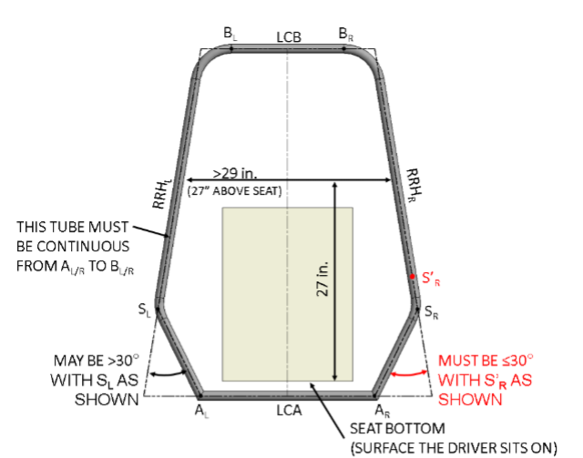
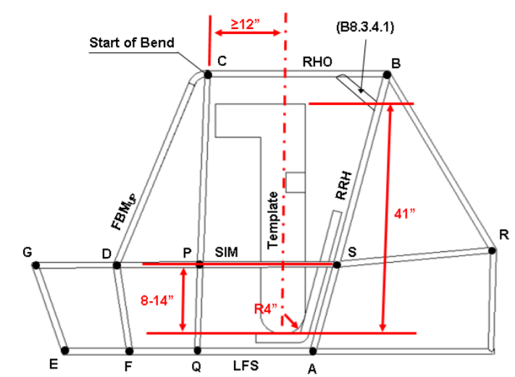
Dimensional Limitations
Rear Roll Hope (RRH) must be at least 29 in wide at a height of 27 in.
Sides can be bent or straight

Slide 9
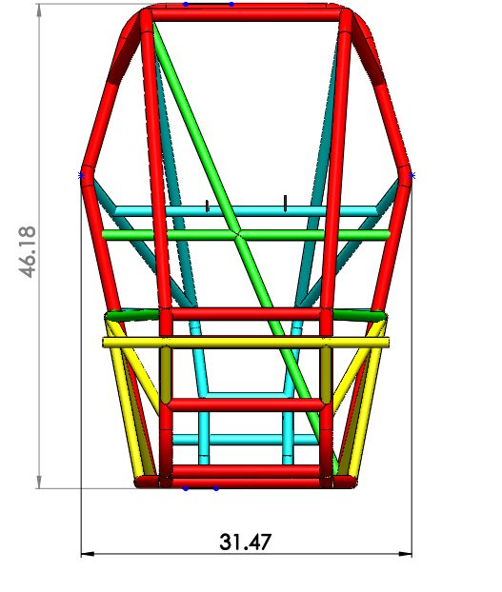
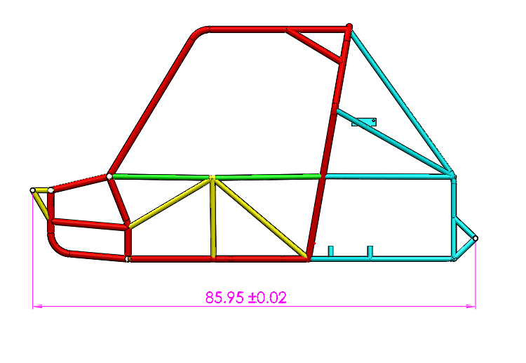
Rules Compliance
Vehicle
Vehicle/Dimensions | Long | Tall (frame) | Width
Rules | 108 in | N/A | 64 in
ZR | 85.95 | 46.175 in | 62 in

Slide 10
Modifications

Slide 11
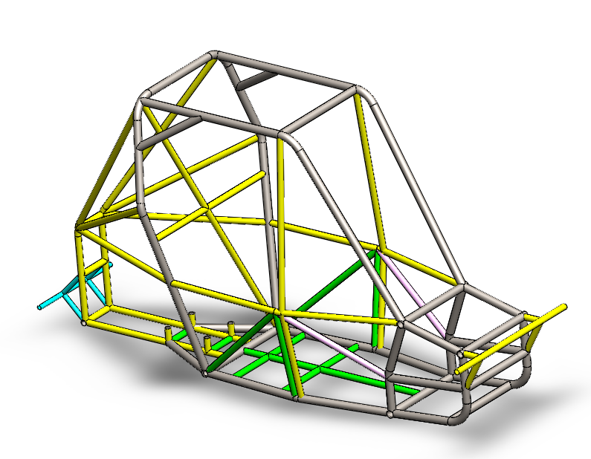
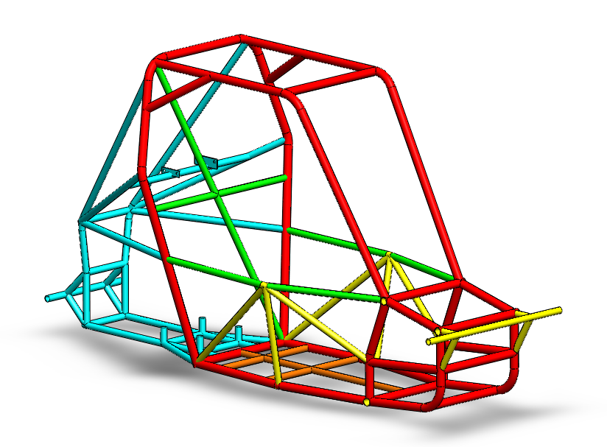
Mass = 81.86 pounds
Mass = 92.16 pounds

Slide 12
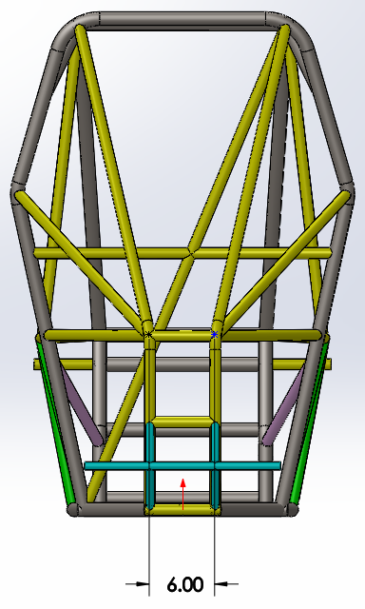
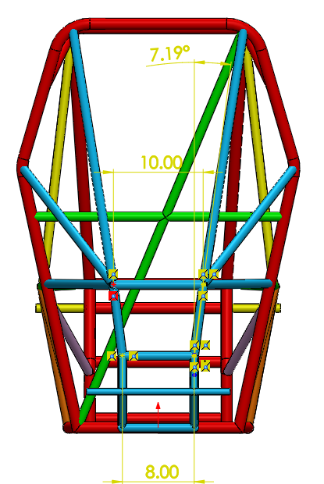
ZR 2016
ZR 2017

Slide 13
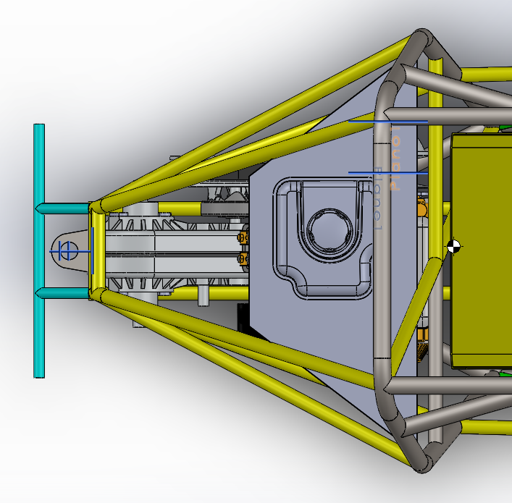
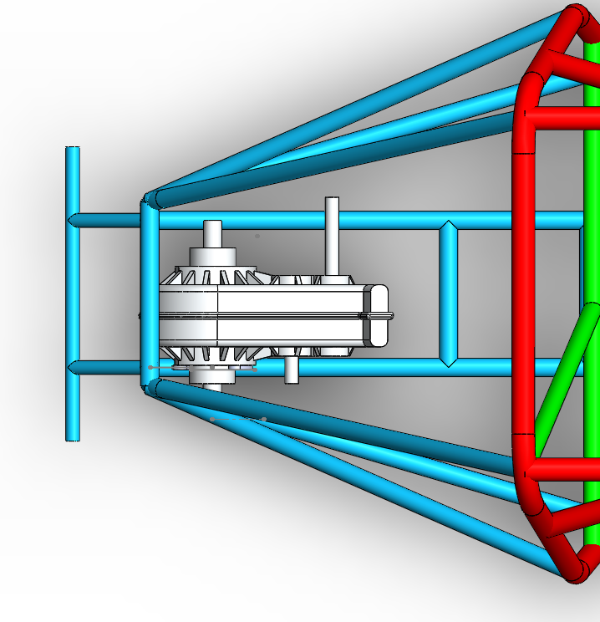
ZR 2016
ZR 2017

Slide 14
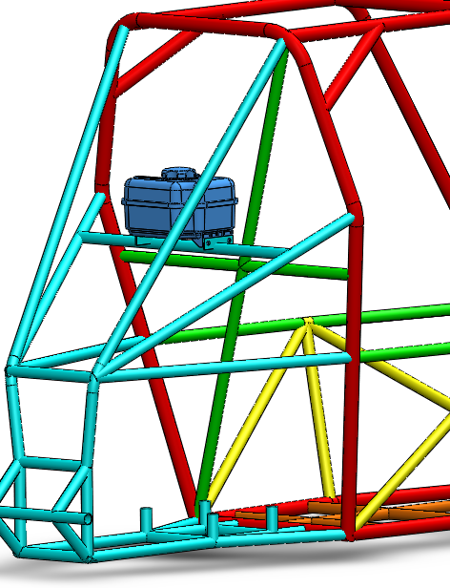
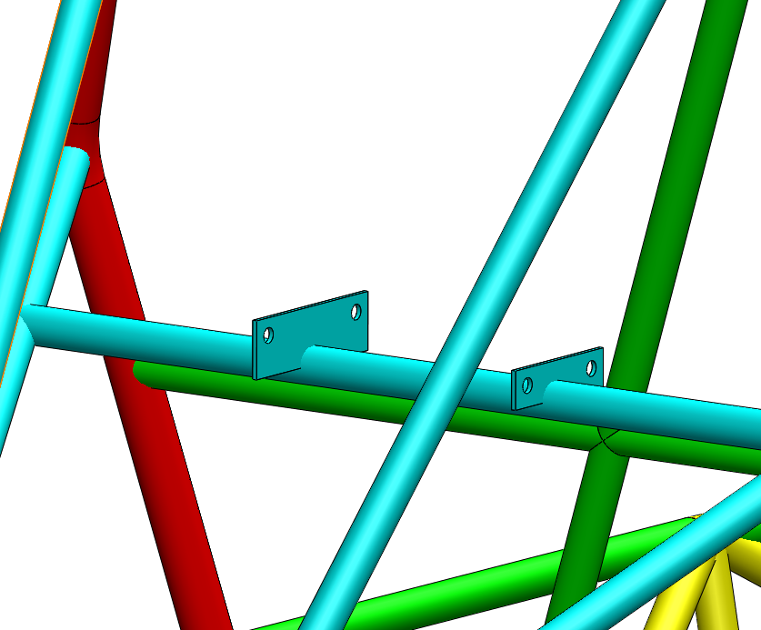

Slide 15
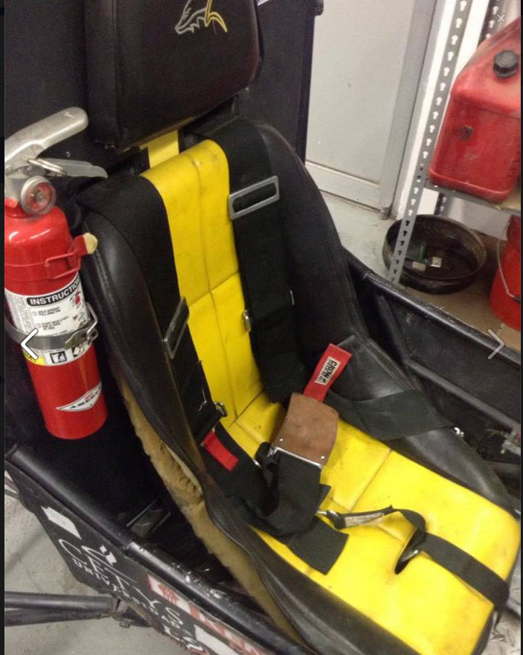
Critical Joints
In order to define the critial joints for the Chassis, we must look for the principal objective of this subsystem that is to keep alive the driver.
Critical joints:
Seat
Safety belts
Head restraint
Steering Wheel
Firewall
Rack & pinion (steering)
Suspensions

Slide 16
Joints with Other Systems

Slide 17
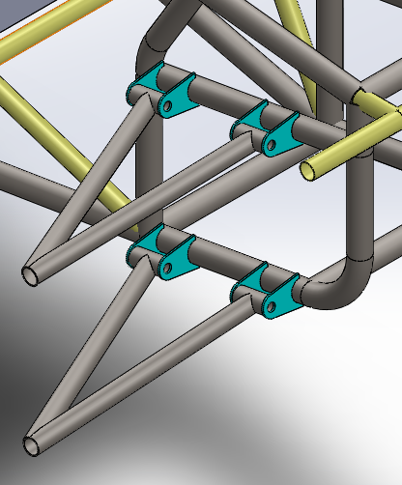
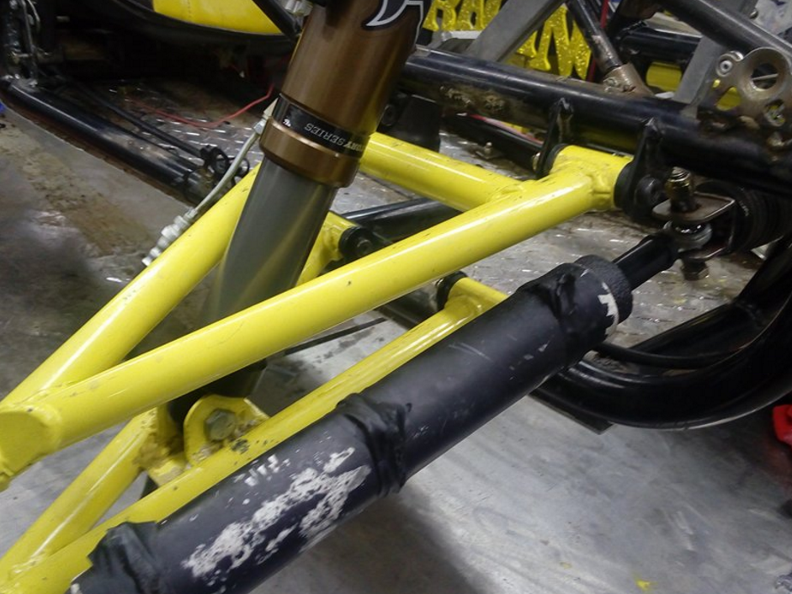
Front Suspension
ZR Front Suspension joint.
ZR Front Suspension joint.

Slide 18
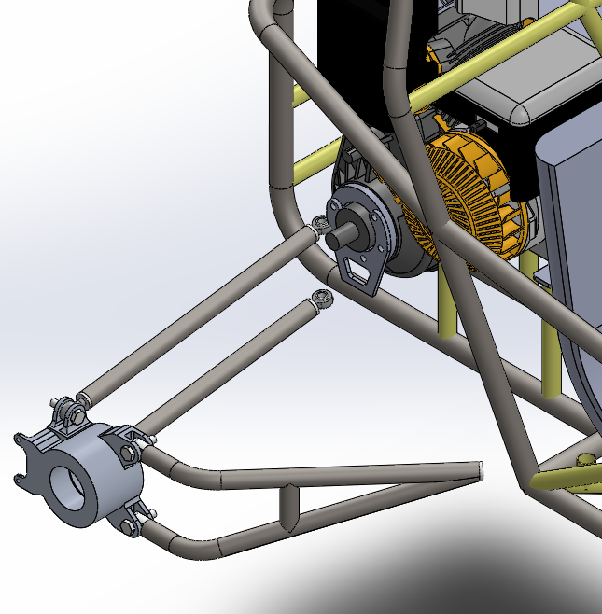
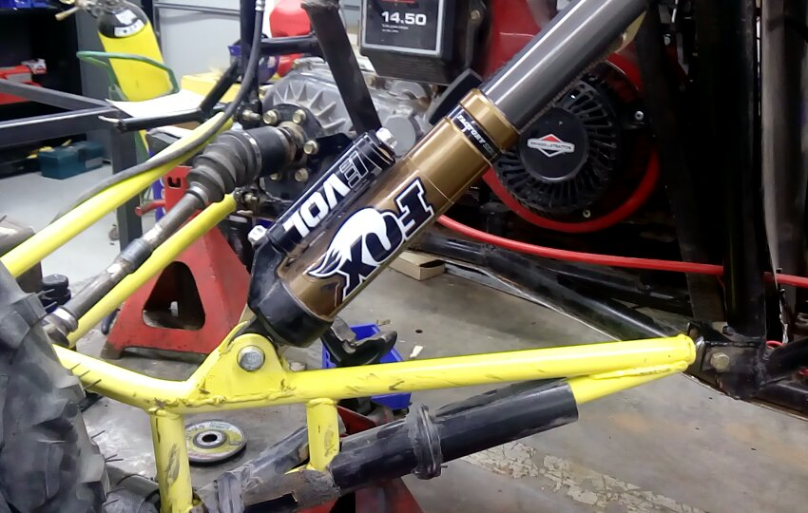
Rear Suspension
ZR Rear Suspension joint with bolt joints.

Slide 19
Structural Analysis

Slide 20
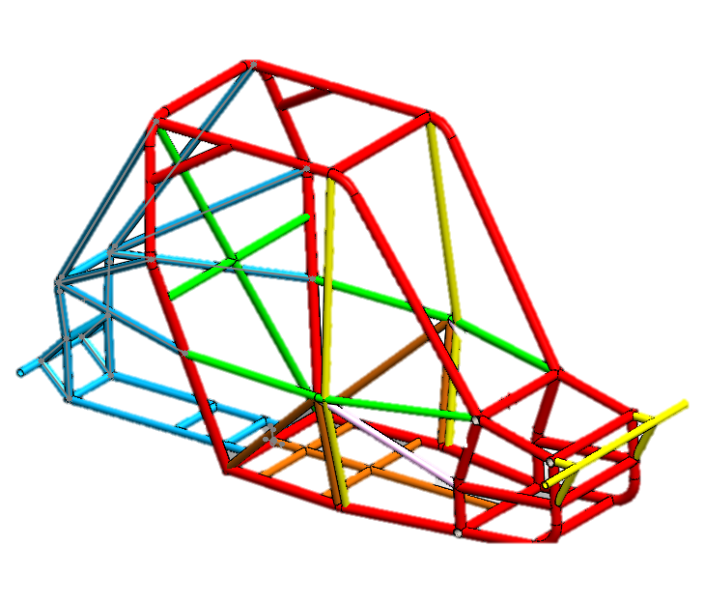
Load cases
Case 1: Front impact
Case 2: Front Rollover
Case 3: Side impact
Case 4: Side Rollover
Case 5: Front long impact

Slide 21
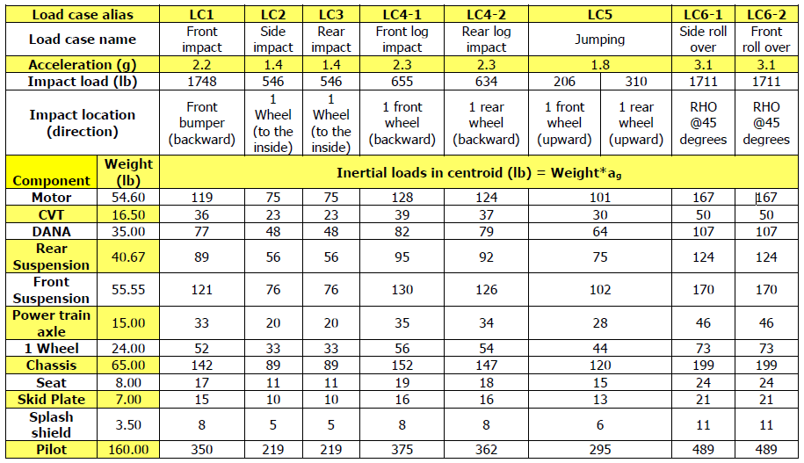
Dynamic Loads

Slide 22
FEM

Slide 23
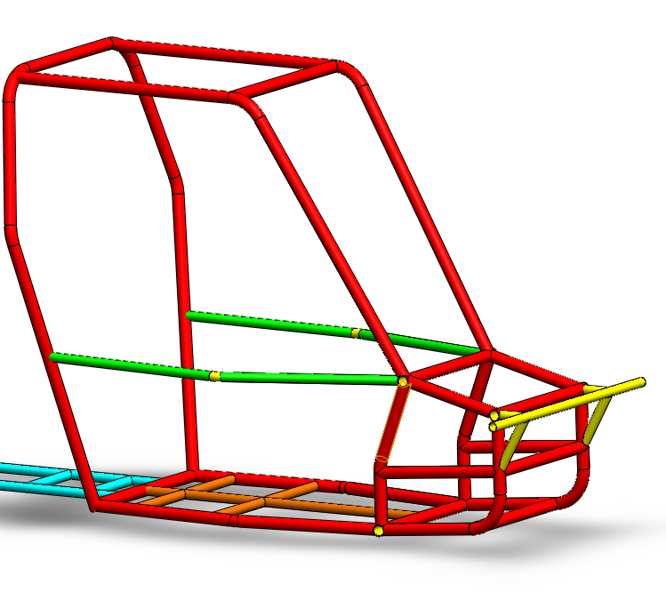
1.25” Diameter 0.065” Thick Tube
Front Suspension Cage
Roll Cage

Slide 24
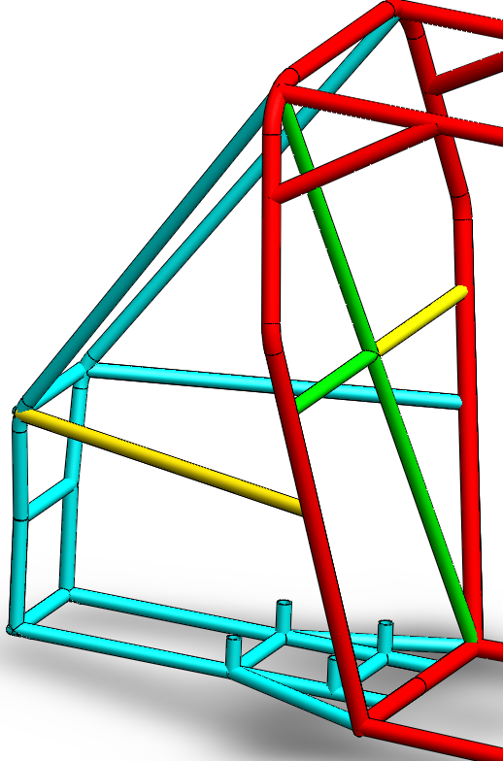
1” Diameter 0.065” Thick Tube
Splash Shield or Firewall
Power Train Cage
*Tubos tojos no son tomados en cuenta

Slide 25
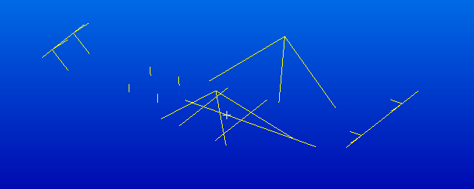
1” Diameter 0.065” Thick Tube
Front and Back Bumpers
Side Support Bars
Motor support Bars
Skid Plate Support

Slide 26
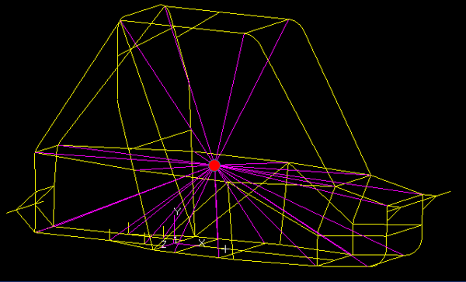
CHASSIS Load Distribution

Slide 27
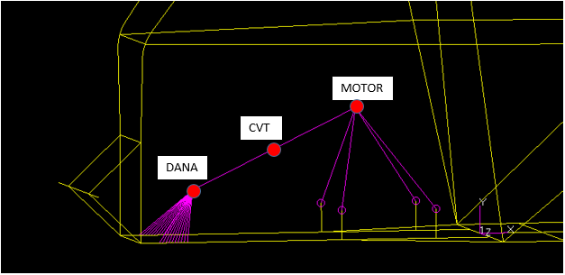
Power Train Load Distribution
RIGID ELEMENT BARS

Slide 28
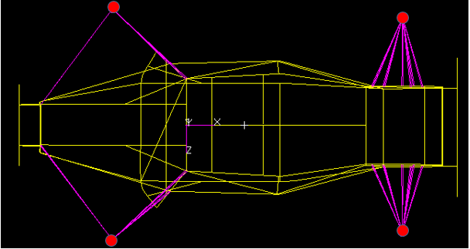
REAR AND FRON SUSPENSION LOAD DISTRIBUTION

Slide 29
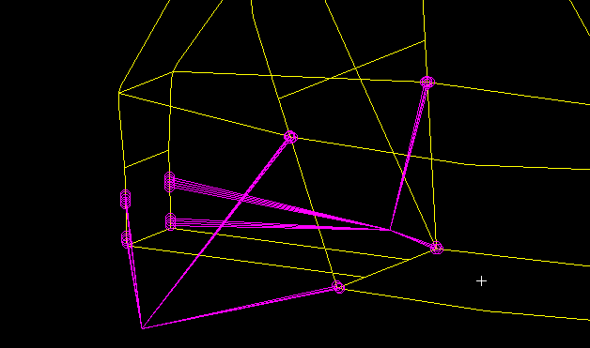
REAR SUSPENSION LOAD DISTRIBUTION

Slide 30
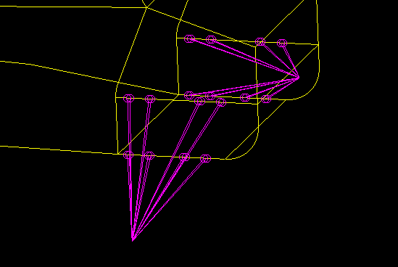
FRONT SUSPENSION LOAD DISTRIBUTION

Slide 31
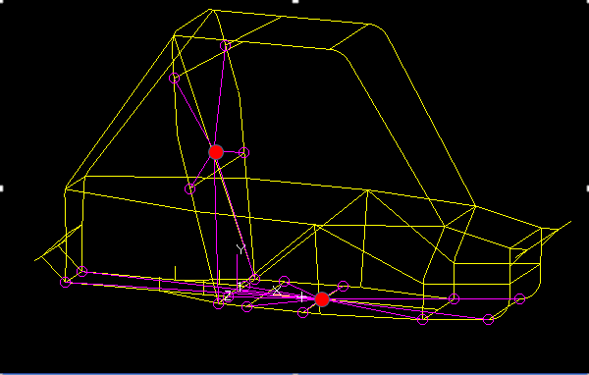
SPLASH AND SKID PLATE LOAD DIST

Slide 32
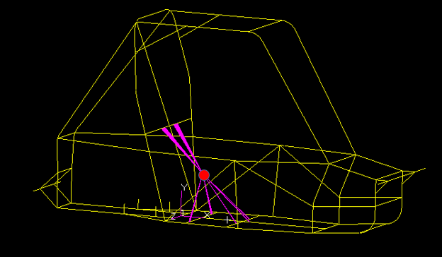
SEAT-PILOT INTERFACE

Slide 33
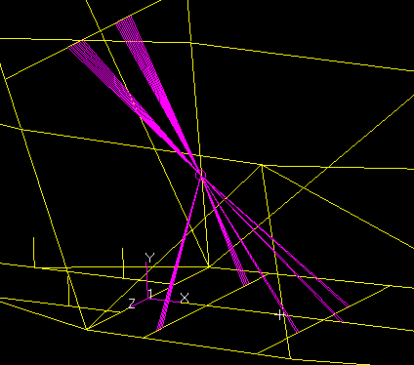

Slide 34
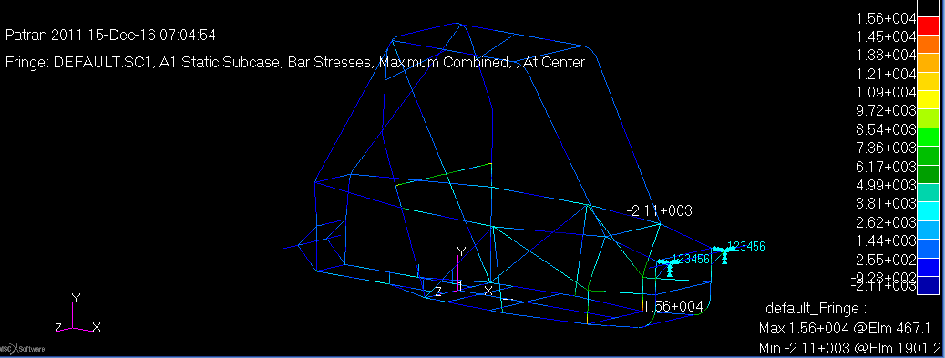
Front Impact
Highest stress concentration 1.56 E+004 PSI.
Welding factor of 1.54
Safety factor of 4.17

Slide 35
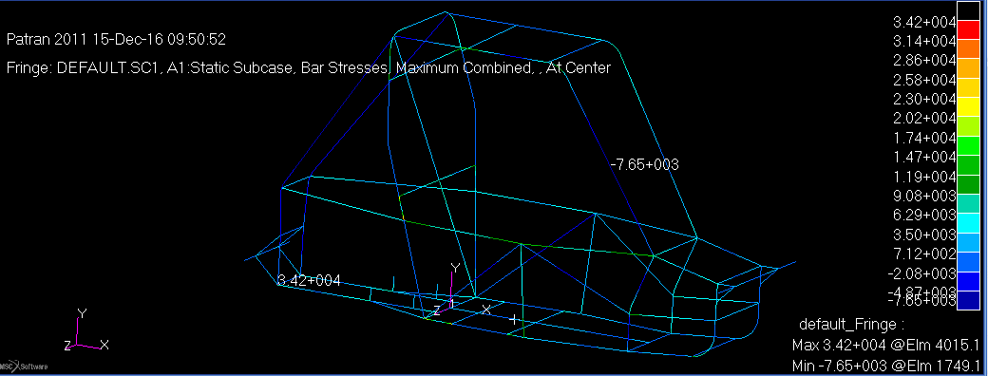
Front Rollover
Maximum combined stress of 3.42 E+004 PSI
Welding factor of 1.54
Factor of safety 1.90.

Slide 36
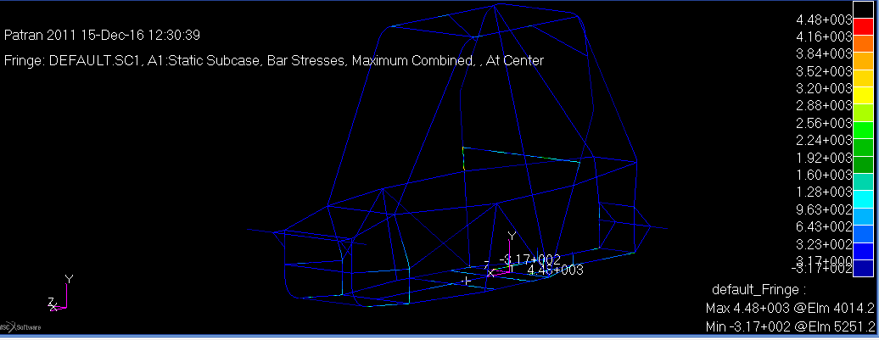
Side impact
Maximum combined stress of 4.48 E+003 PSI
Welding factor of 1.54
Factor of safety 14.53.

Slide 37
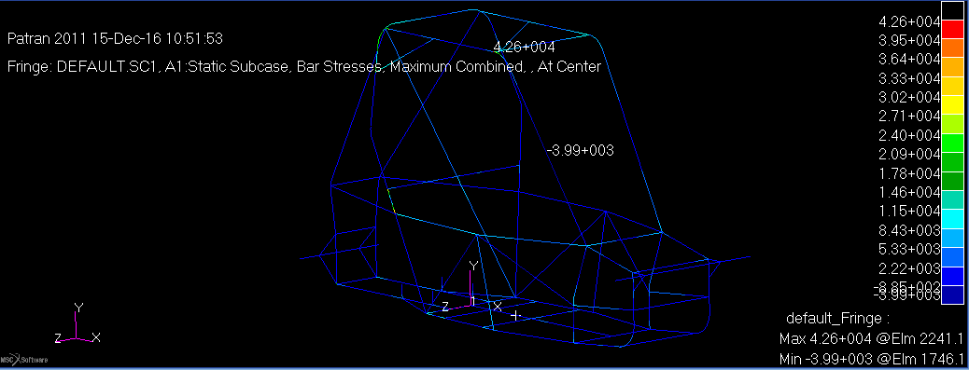
Side Rollover
Maximum combined stress of 4.26 E+004 PSI
Welding factor of 1.54
Factor of safety 1.52.

Slide 38
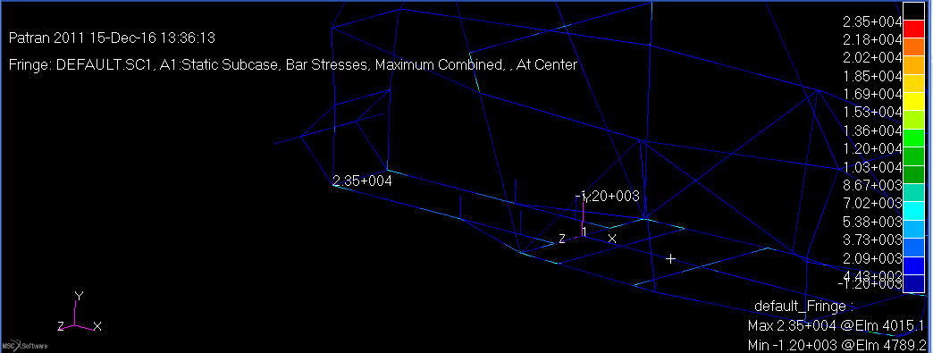
Front Long Impact
Maximum combined stress of 2.35 E+004 PSI
Welding factor of 1.54
Factor of safety 2.77

Slide 39
 | Max G’s applied | Yield Strength | Maximum Stress | Safety Factor
Load Case 1 Front Impact | 1.2 | 66 717.35 psi | 15 600 psi | 4.17
Load Case 2 Front rollover | 3.1 | 66 717.35 psi | 34 200 psi | 1.90
Load case 4 Side impact | 1.4 | 66 717.35 psi | 44 800 psi | 14.53
Load Case 3 Side rollover | 3.1 | 66 717.35 psi | 42 600 psi | 1.52
Load case 5 Front long impact | 2.3 | 66 717.35 psi | 23 500 psi | 2.77

